Slide 1


Accenture Data Analytics & Visualizations

Slide 2


Today's agenda
Project recap
Problem
The Analytics team
Process
Insights
Summary

Slide 3

Social Buzz is a fast growing technology unicorn that q quickly to it's global scale. Accenture has begun a 3 month P month POC focusing on 3 tasks:-
- An audit of their big data practice
- Recommendations for a successful IPO
- An analysis of their content categories that h highlights the top 5 categories with the
largest aggregate popularity
Project Recap

Slide 4

Problem
Over 100000 posts per day
36,500,000 pieces of content per year!
But how to capitalize on it when there is so much?
Analysis to find Social Buzz's top 5 most popular categories of content

Slide 5



Andrew Fleming
Chief Technical Architect
The Analytics team
Marcus Rompton
Senior Principle
Komal Khanna
Data Analyst

Slide 6
Process
1
Data Understanding
2
Data Cleaning
3
Data Modelling
4
Data Analysis
5
Uncover insights

Slide 7

Insights
16
Number Of Unique Categories
1897
Reactions to "ANIMAL" Posts
MAY
Month with Most Posts

Slide 8
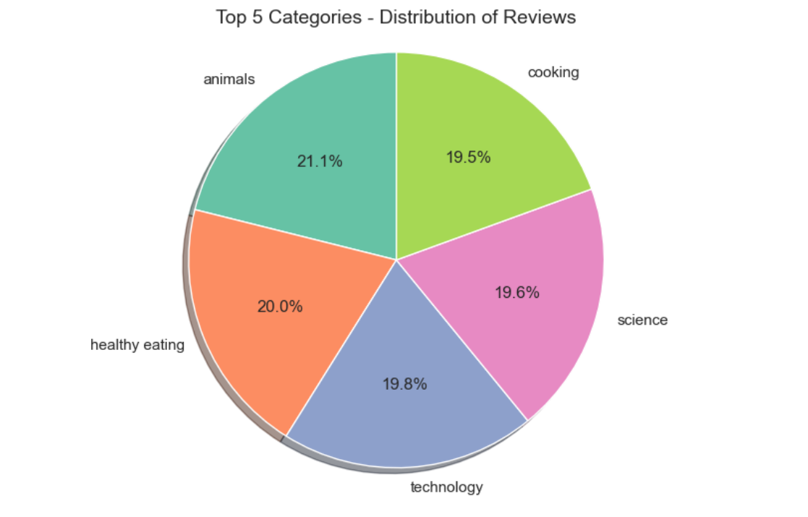

Slide 9
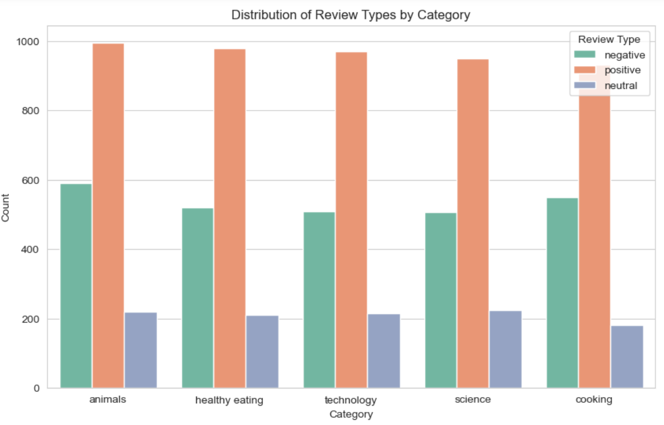

Slide 10

Analysis: Animals and Healthy Eating are the two most popular categories of content, showing that people enjoy "real-life" and "factual" content the most.
Insights: The top 5 categories in our user base revolve around food, particularly "Healthy Eating" ranking the highest. This insight suggests collaborating with healthy eating brands to create a campaign and increase user engagement.
Summary
Next Steps: This insightful ad-hoc analysis calls for scaling it up to achieve real-time business understanding. We can guide you in implementing this on a larger scale.

Slide 11

Thank you!
ANY QUSTIONS?

